Slide 1
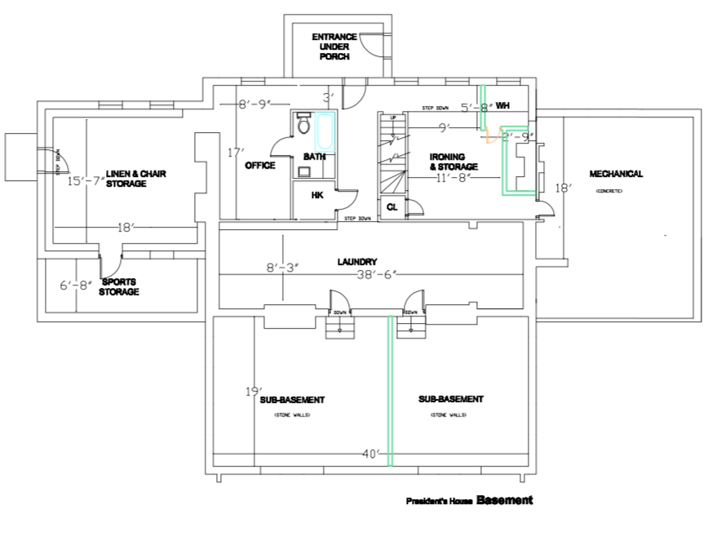
B.7
B.8
B.0
B.6
B.1
B.4
B.5
B.2
B.3

Slide 2
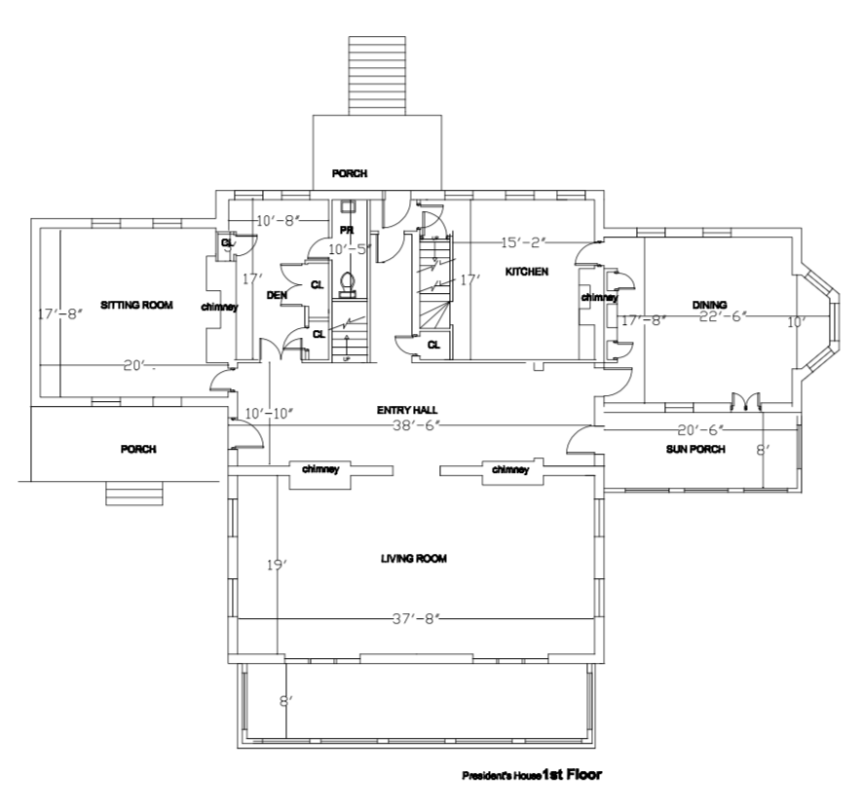
1.9
1.1
1.7
1.8
1.0
1.2
1.6
1.3
1.4
1.5

Slide 3
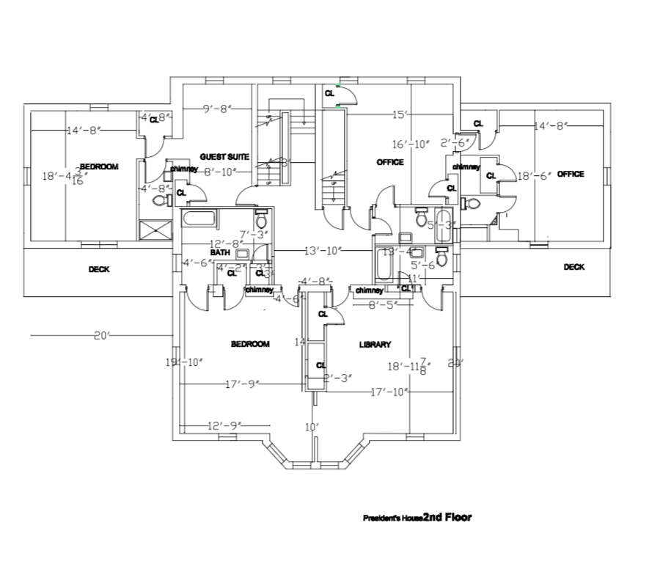
2.9
2.1
2.0
2.8
2.2
2.7
2.4
2.3
2.6
2.5

Slide 4
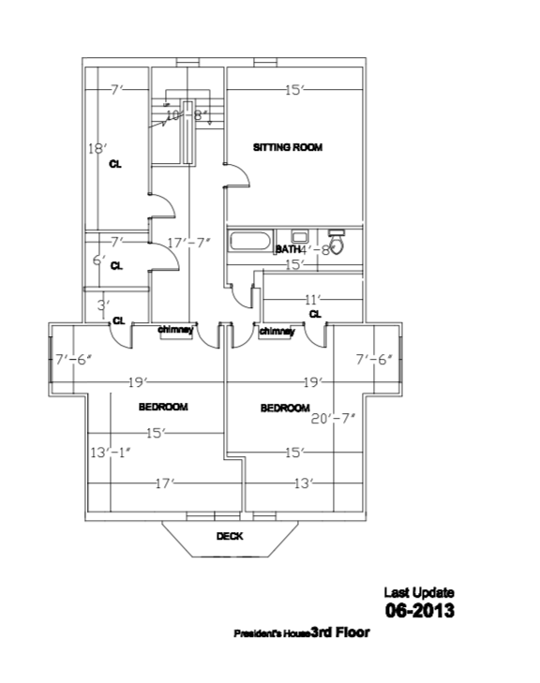
3.6
3.0
3.1
3.2
3.3
3.5
3.4

