Slide 1
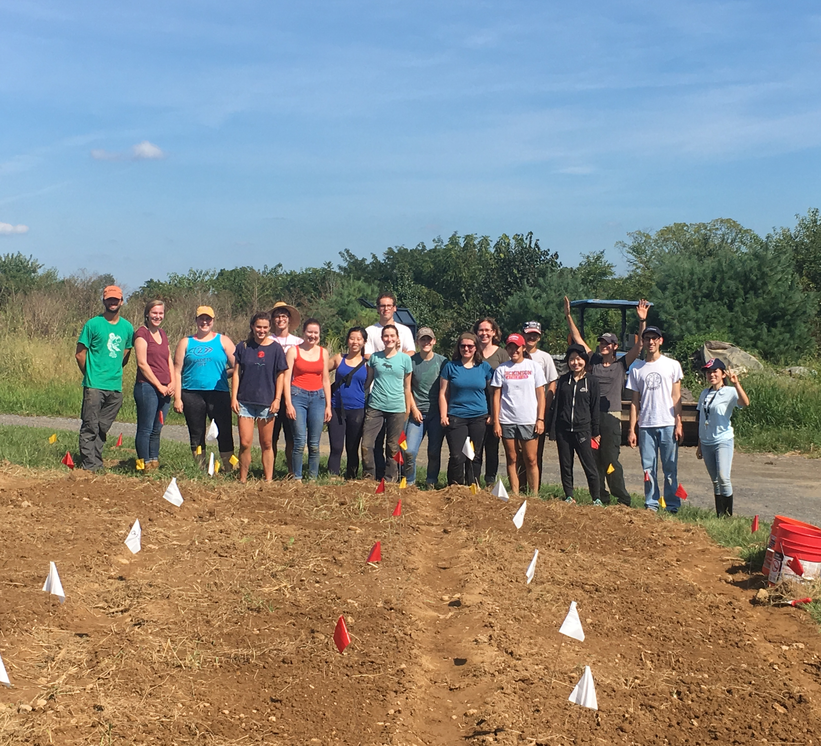
A Perspective on home gardening
With Prof. Maggie Douglas

Slide 2
Prof. Douglas uses home gardening as a creative outlet, a way to get to know her neighbors and as a large source of vitamins and minerals during peak season

Slide 3
Flexibility
Home gardening allows for experimentation with different hybrid crop varieties and unique foods based on the gardener's preferences.

Slide 4
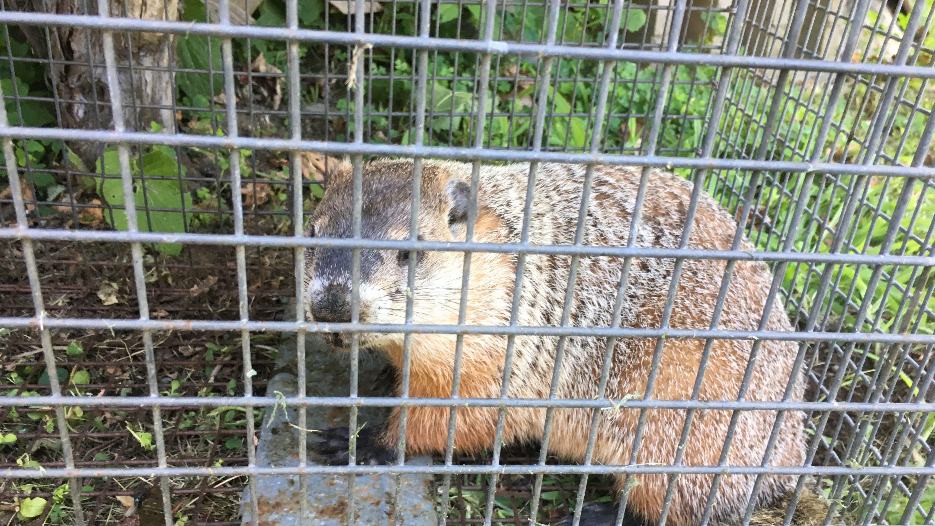
Pests
The enemy of a home gardener. Elaborate fencing keep rabbits and groundhogs out. Monitoring of insects can help save the vegetables

Slide 5
Peak season
Production is high! Vegetables are eaten, given away or preserved for further use.

