Slide 1
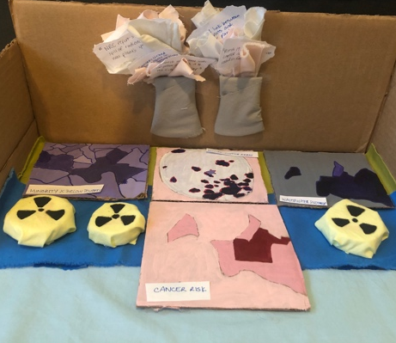
Limerick Generating Station: Nuclear Power, Radiation Exposure, and Cancer risk/rate among black residents of Pottstown, PA
Grace Gontarek
Top left graph: proportion of minority population that lives below the poverty line in Pottstown, PA. Obtained from EJ Screen.
Top middle graph: areas within a 50-mile radius of the Limerick Generating Station that are deemed “Environmental Justice Areas.” Obtained from the Nuclear Regulatory Commission (NRC).
Top right graph: depiction of wastewater discharge in Pottstown, PA. Obtained from EJ Screen.
Bottom middle graph: depiction of Pottstown (red) cancer risk based on national percentiles (80-90th percentile). Obtained from EJ Screen.
Headlines written on recycled paper pertaining to environmental bads produced by the LGS, stuffed in the “steam” of the cardboard power plant towers.
Headlines:
“NRC report shows March spill of radioactive water was plant's 4th in four years.“
“LETTER: A link between cancer rates and nuclear plants?”
“Exelon Nuclear’s Limerick Generating Station leaks 100 gallons of bleach in to the Schuylkill River. “
“Cancer-Linked Contaminants in Pottstown Drinking Water: Report”
Hazardous waste signs made out of old medicine bottle caps + old pillow cases. Bottle caps represent the authorized distribution of potassium iodide pills to local residents to protect thyroid from radiation damage.

Slide 2
Exhibit Note
Just sustainability is the insurance of our environment’s compatibility with quality of life and wellbeing for every person. Income and exposure to environmental burdens must be equalized across all races, so that a safe and just space for all humanity can be created. Quality of life depends on the living conditions of residents and their capabilities within their area. We must improve the quality of life and wellbeing for all citizens in order to alleviate the burden of unjust sustainability. (Agyeman 2013) At the edge of Limerick Township, PA, there is a nuclear power plant called the Limerick Generating Station. The Limerick Generating Station has had multiple instances of spills and pollution that gets into the Schuylkill River (Brandt 2012). Additionally, radioactive isotopes such as tritium and strontium-90 are consistently detected in surface water and groundwater surrounding LGS, sometimes in high concentrations. These isotopes are linked to thyroid cancer, of which Pottstown and Montgomery County in general have a disproportionately high rate and risk (CDC 2020). Pottstown, located adjacent to the power plant, has a cluster of high black population that identifies as low-income. Part of Pottstown’s cancer risk comes from the Limerick Generating Station’s release of radiation into the surrounding surface water and groundwater: specifically, tritium and strontium-90. This is an un-just sustainability because the black population of Pottstown has a disproportionately high rate of thyroid cancer, as found through CDC cancer case reports, which is linked to the detections of radioactive isotopes in the waterways released by Limerick Generating Station.

Slide 3
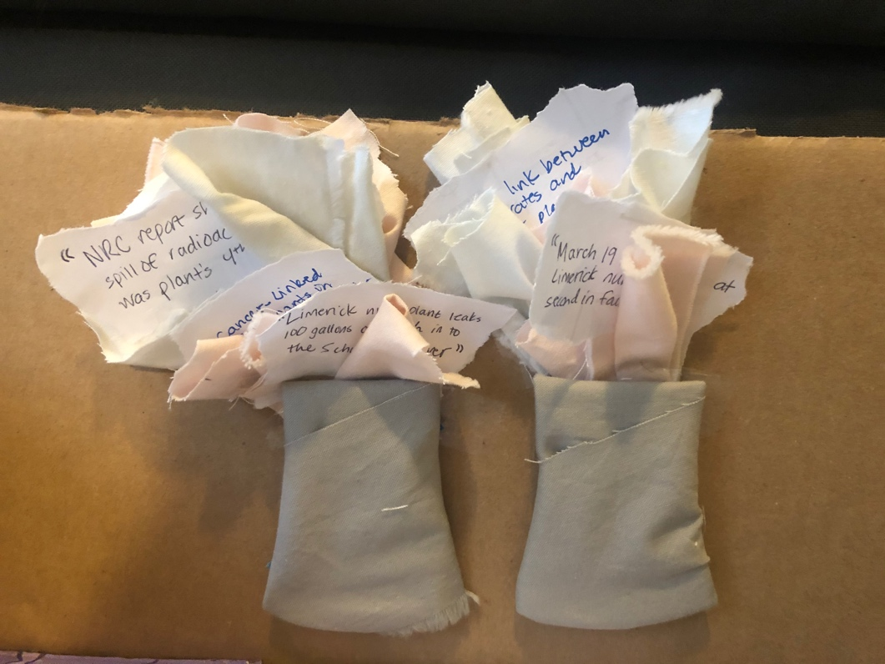
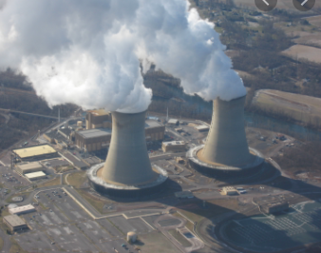
Visual Representation
Actual Photo of Limerick Generating Station

Slide 4
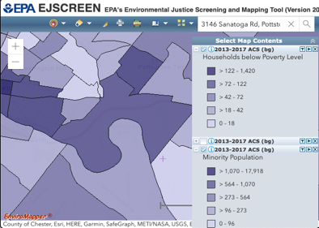
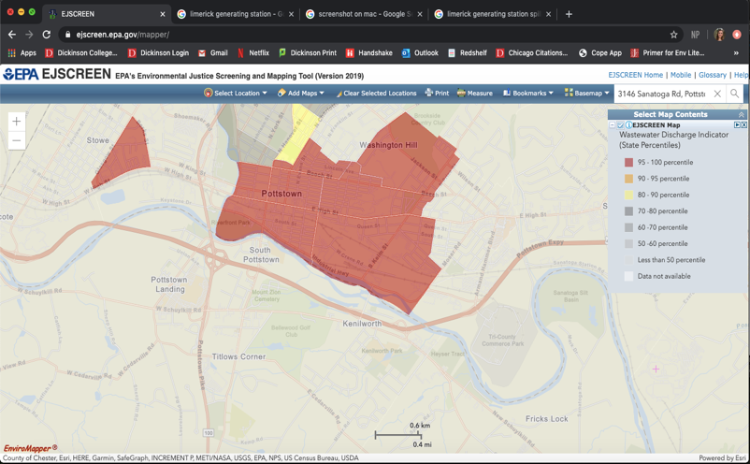
Limerick Generating Station

Slide 5
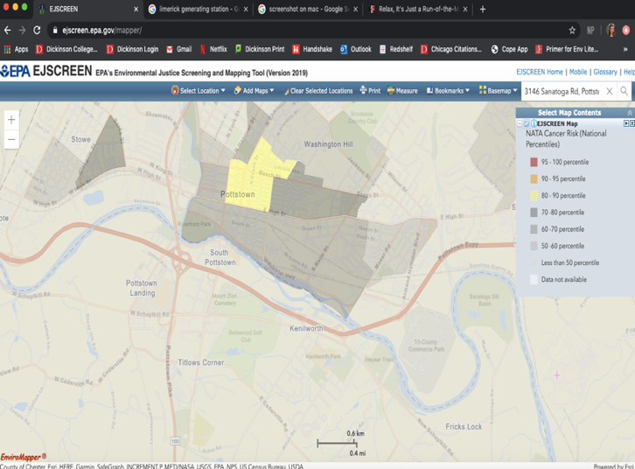
Limerick Generating Station/ Pottstown

Slide 6
Limerick Generating Station and Cancer:
Pottstown’s Disproportionate Burden
-Pottstown has a high minority population that identifies as low-income.
-Pottstown cancer risk: 80-90th percentile nationally.
-Pottstown is located in an area with high wastewater discharge (95-100th percentile state-wide).
-Pottstown has a high percentage of black residents reporting thyroid cancer cases—thyroid cancer is closely linked to radiation exposure. (CDC)
-Tritium and strontium-90.
-Pottstown childhood cancer rate: 93% above the rest of the region in late 1990s and early 2000s. (Mangano 2017)
-Study found high average levels of strontium-90 in 100+ baby teeth, 50% higher than areas located far from a nuclear power plant. (Mangano 2017)

Slide 7
2012: 15,000 gallons of tritium-contaminated water spilled into surrounding water ways.
Sample: concentration of tritium was 113,000 pci/L
-the EPA’s limit is 20,000 pci/L.
(Brandt 2012)
-The Nuclear Regulatory Commission (NRC) has a shady history of evaluating environmental injustice and environmental health risk.
-EIJ criteria, meaningless reform, misleading campaigns, safety procedure. (Jantz 2017)
2008 Radiological Report: levels of Strontium-90 in surface water deemed “Acceptable With Warning.” (NRC 2008)
685 out of total 1,978 census tracts within a 50-mile radius of LGS were identified as Environmental Injustice Areas
Of the EIJ areas, 424 out of 685 are in the black race category, with 191 tracts being over 50% aggregate black population. (Exelon Generating Company 2014)

